Slide 1
FashionWave Retail Sales Analysis
Customer & Product Insights
Prepared by: Nishanth B G

Slide 2
Business Scenario / Overview
• FashionWave is a mid-sized retail chain with 50 stores across India.
• Weekend sales are stagnant while weekday sales remain consistent.
Business Problem:
• Identify drivers of sales performance.
• Understand weak weekend performance.
Objectives:
• Increase weekend sales by 15%.
• Improve product-level profitability.
• Optimize discount strategy.

Slide 3
Dataset & Methodology
Dataset: fashionwave_sales.csv (last 2 years, 50 stores)
Key Columns: ProductID, StoreID, CustomerType, Category, Revenue, Cost, Discount
Derived Fields: DayOfWeek, IsWeekend, Profit = Revenue - Cost
Missing values handled for Discount & CustomerType
Assumptions: Discounts ≤ 30%, seasonal effects included

Slide 4
Key Performance Indicators (KPIs)
Total Sales – Total revenue per store per week
Average Order Value (AOV) – Revenue per transaction
Profit Margin – Revenue minus cost
Units Sold per Product – Items sold in each category
Discount Impact – Profit margin change under discounts
Weekend vs Weekday Sales Ratio

Slide 5
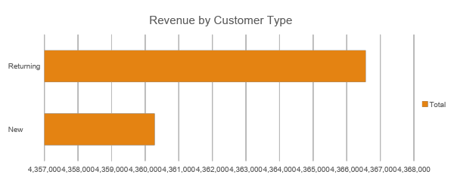
Customer Type: New vs Returning
Insights:
1. Returning customers contribute ~70% of revenue.
2. New customers require targeted acquisition campaigns.

Slide 6
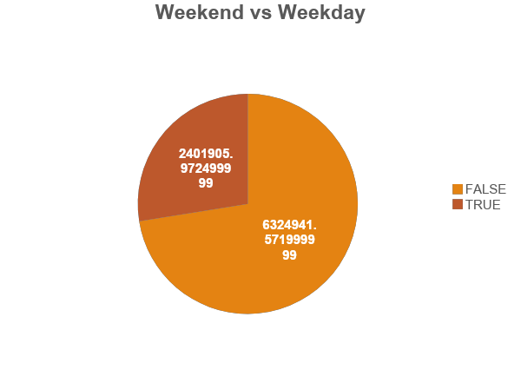
Weekend vs Weekday Sales Analysis
Insights:
Weekend sales remain stagnant compared to weekdays. Focused weekend promotions are needed to boost revenue by 15%

Slide 7
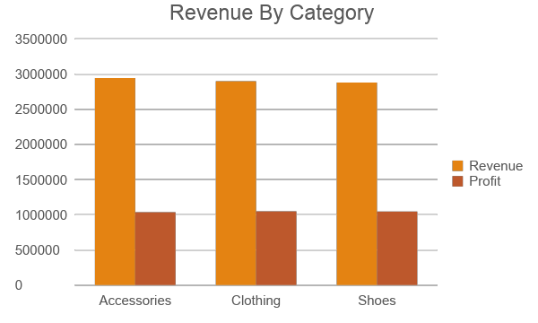
Product Category Performance (Revenue & Profit)
Insights:
1. Top categories drive most revenue & profit.
2. Low-performing categories need review.

Slide 8
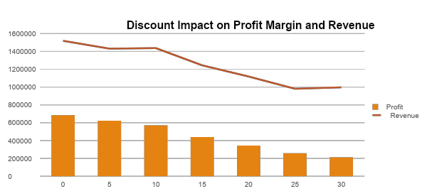
Discount Impact on Profit Margin
Insights:
1. Higher discounts reduce profit margin sharply.
2. Recommended: Targeted discounts, max depth = 30%.

Slide 9
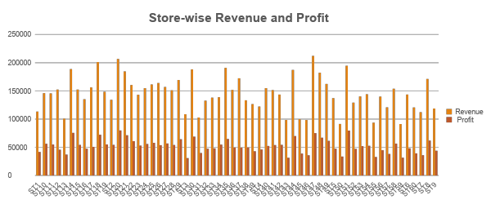
Store-level Performance
Insights:
1. High-performing stores provide best-practice benchmarks.
2. Low-performing stores need localized strategy.

Slide 10
Customer Segmentation (Simple)
• Segments: Loyal (High Spend), Frequent, Occasional
Insights:
1. Loyal customers need retention programs.
2. Occasional users need acquisition incentives.

Slide 11
Recommendations
Quick Wins:
• Weekend promotions
• Loyalty rewards
• Push top categories
Long-term:
• Discount optimization
• Store-specific plans
• Customer segmentation

Slide 12
Appendix & Assumptions
Revenue = Price × Units Sold
Profit = Revenue - Cost
DayOfWeek & IsWeekend derived from date
Future work: Seasonality analysis, dashboard

